Slide 1
Secure data hiding in image using steganography
CAPSTONE PROJECT
Presented By :
Student Name : Saumy Ladkar
College Name & Department : Shri Shankaracharya Technical campus & Computer science department

Slide 2
OUTLINE
Problem Statement
Technology used
Wow factor
End users
Result
Conclusion
Git-hub Link
Future scope

Slide 3
Problem Statement
This project aims to develop a steganography technique for securely embedding secret messages within digital images. The message is encoded by modifying pixel values, ensuring undetectable communication. A password is used for decryption, ensuring that only authorized users can retrieve the hidden message. The goal is to provide a secure and efficient method for information hiding while maintaining image quality.

Slide 4
Technology used
OpenCV: Library for image processing.
Python: Programming language for implementation.
Image Processing: Modifying image pixels for data embedding.
ASCII Encoding: Converting text to ASCII values.
Password Security: Ensuring authorized decryption access

Slide 5
Wow factors
Image-Based Steganography: Hides messages in pixels.
Password Protection: Secures message access.
Efficient Image Space Use: Optimizes pixel storage.
Simple Yet Effective: Basic, robust techniques.
End-to-End Steganography: Full encryption and decryption.

Slide 6
End users
The end users of this steganography project could include:
Individuals: Those seeking private communication without detection.
Security Professionals: For secure data transmission and protection.
Organizations: To protect sensitive information in digital formats.
Researchers/Developers: Interested in digital security or steganography techniques.
Cybersecurity Enthusiasts: People studying or exploring data concealment methods.

Slide 7
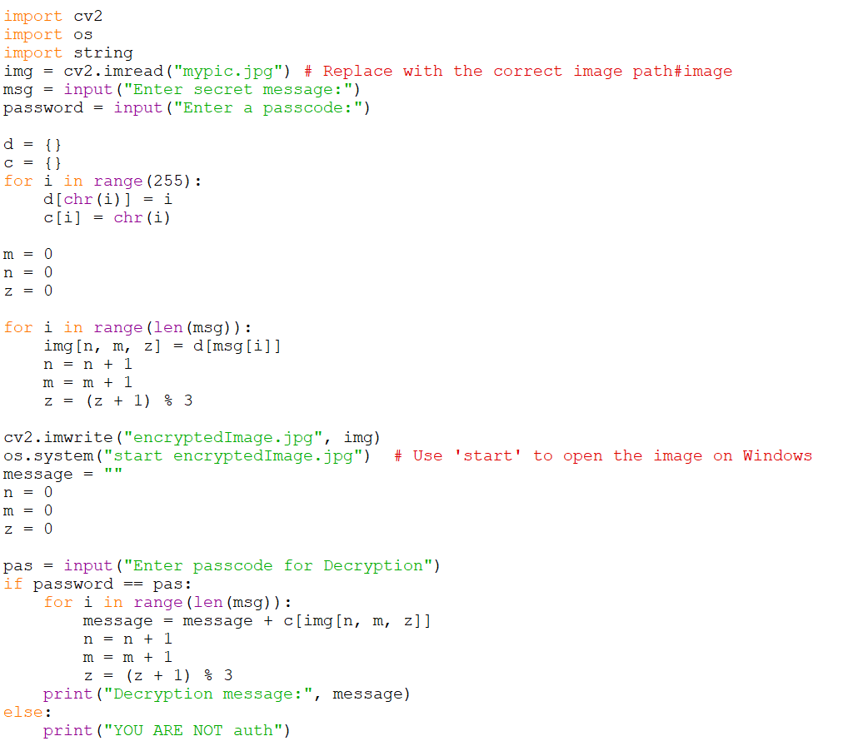
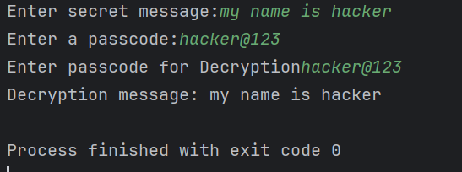
Results
Source code
Output

Slide 8
Conclusion
In conclusion, this steganography project successfully addresses the challenge of securely embedding hidden messages within digital images, ensuring both confidentiality and undetectability. By using pixel manipulation to encode the secret message and implementing password-based decryption, it adds an extra layer of security. The project highlights an efficient and simple approach to information hiding, while maintaining the integrity of the image and providing a complete end-to-end solution for encryption and decryption. This technique is valuable for individuals and organizations seeking secure communication channels that remain imperceptible to unauthorized parties.

Slide 9
GitHub Link
https://github.com/saumyladkar/myproject_aicte.git

Slide 10
THANK YOU

